Slide 1
Training a Model
Notes:
We’ll start with a discussion of how DNNs enable an entirely new way of solving problems.

Slide 2
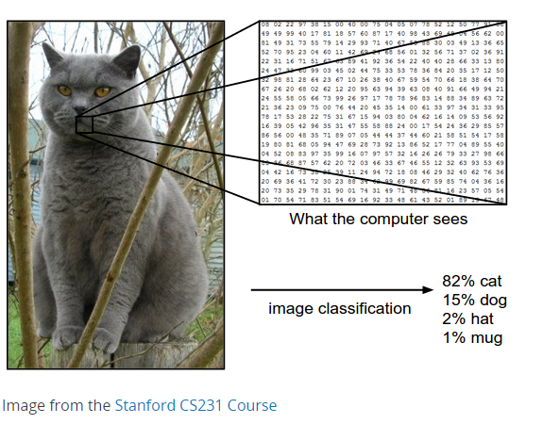
Inputs and Outputs

Slide 3
Learning Principle
Dataset
Output/Prediction
Target Output
x₁
x₂
…..
x_{n}
Error:
-
= 5
Notes:
Let’s take a look at what just happened.
What you are looking at here is another simplified version of a deep neural network. On the bottom we have the inputs, in this case they might represent each pixel value of an image. On the top we have an output that is generated, in this case it could be the probability the image contains a dog. On the left, you can see the output that *should* have been generated…in this case, if the image were a dog, the output *should* have been 100%.
We feed each image through the network to get a prediction which at first will be wrong. In this case, we’re saying it’s 5 units away from what it should have been (maybe it said 95% likelihood of being a dog).
Then, we change the network in some small way. [Next slide]

Slide 4
Learning Principle
Output/Prediction
Target Output
x₁
x₂
…..
x_{n}
Error:
-
= 15
Notes:
What we change are the coefficients, the multipliers attached to each operation, what we call the ‘weights.’ You can see in this visual, we tried to make this top left “weight” bigger.
What effect did that have on the error?
Exactly. So what do you think we should have done instead?
Exactly. [Next slide]

Slide 5
Learning Principle
Output/Prediction
Target Output
x₁
x₂
…..
x_{n}
Error:
-
= 2.5
Notes:
Clearly this is the goal. Change each weight by a small amount in the direction that decreases the error. Note that this is one of hundreds of thousands or millions of weights in a neural network.
[Feel free to share partial derivatives here but make sure to let the class know that THEY DON”T CALUCLATE THEM AND YOUR SHARING FOR THE NEAT FACTOR]
We call this method “Stochastic Gradient Descent”.

Slide 6
DEEP LEARNING APPROACH - TRAINING
Process
Forward propagation yields an inferred label for each training image
Loss function used to calculate difference between known label and predicted label for each image
Weights are adjusted during backward propagation
Repeat the process
Forward propagation
Backward propagation
Input
Notes:
So in practice, we take an input (in this case an image), pass it through a network and calculate the error, or loss. This is called forward propagation. That loss is then passed back through the network to adjust each of the weights by a small amount in the direction that reduces the loss. This is called backward propagation.
We do this over and over again with thousands of pieces of data with a goal of “learning” a function that takes an input and generates an output that is as close as possible to the target.

